Slide 1





Mini Project
BIKE SHARING DEMAND PREDICTION
Mrudula A P

Slide 2

POINTS FOR DISCUSSION
Problem Statement
Tech Stack Used
Data Description
Data Preparation and Cleaning
Exploratory Data Analysis
6. Hypothesis Testing
7. Feature Engineering
8. Model Implementation
9. Model Interpretation
10. Conclusion

Slide 3

PROBLEM STATEMENT
Unleashing the Power of Bike Sharing with Precision Demand Predictions
The introduction of rental bikes in various urban areas has notably enhanced mobility comfort. It is imperative to ensure the timely availability and accessibility of rental bikes to minimize waiting times. The imperative of sustaining a stable supply of rental bikes in the city is a pressing concern. Accurately gauging bike demand at specific times is especially vital for bike rental companies.
Our primary goal is to address this challenge by creating a solution that forecasts bike demand, considering diverse factors such as city weather conditions and different times of the day.

Slide 4








TECH STACK USED

Slide 5
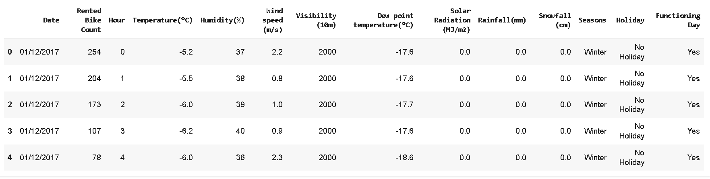
DATA DESCRIPTION
The Bike Sharing Demand Dataset contains information about bike rentals in Seoul from Dec 2017 to Nov 2018. It includes hourly observations of bike rentals, such as the date, time, number of rented bikes, weather conditions, and other factors that may influence bike rental demand.
The dataset that we are working with contains 8,760 observations and 14 features.

Slide 6
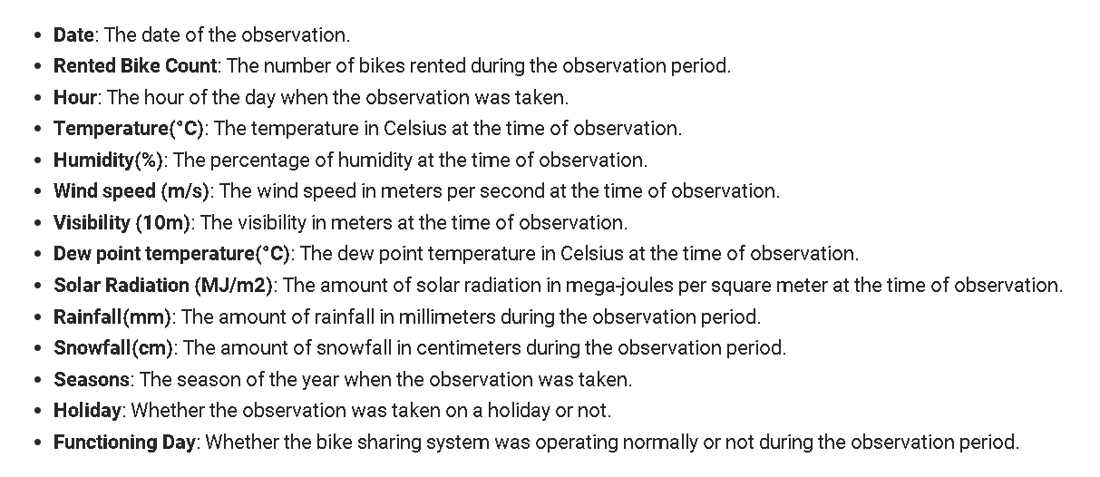
DATA DICTIONARY

Slide 7
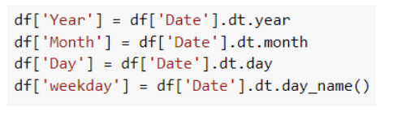
DATA PREPARATION & CLEANING
There were no duplicate rows in the dataset.
There were no missing values in the dataset.
Changed datatype of Date to datetime.
Created new columns for better visualize the data
Changed Data types of numerical columns which represents categories like Year, Month, Day to categorical data type
1. Year, Month, Day, Weekday from Date
2. Temperature Bin from Temperature(°C)

Slide 8
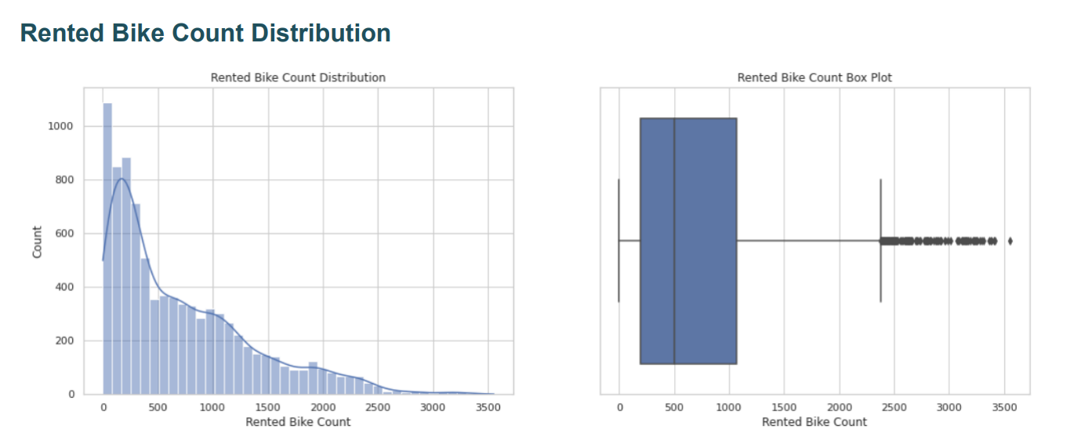
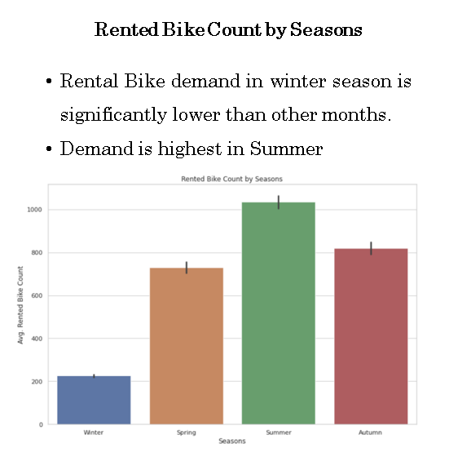
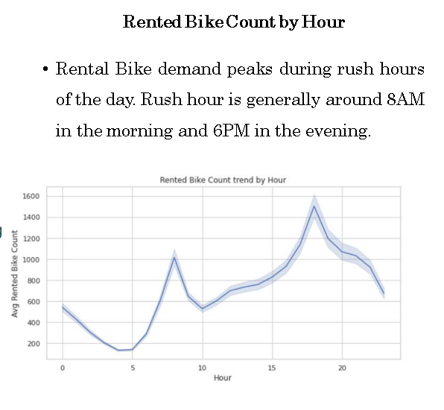
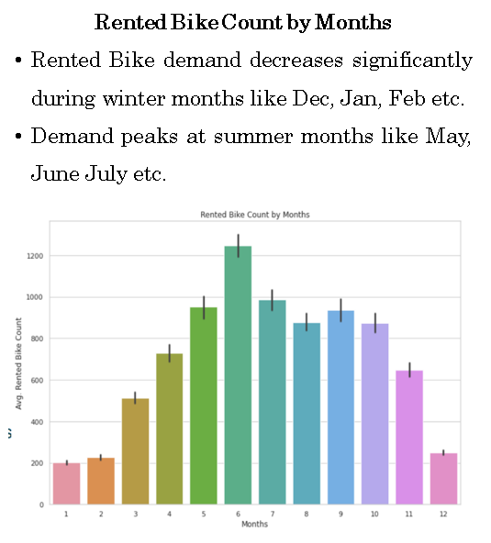
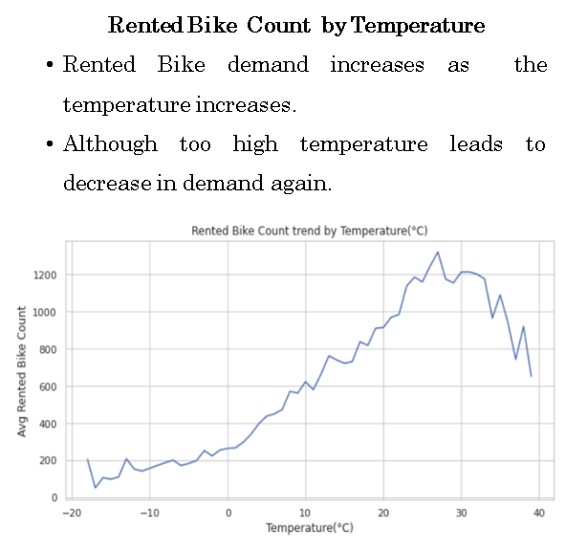
EXPLORATORY DATA ANALYSIS

Slide 9
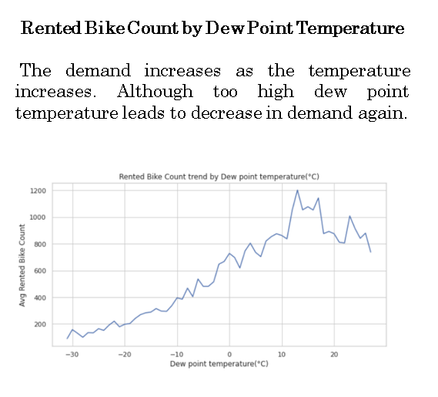
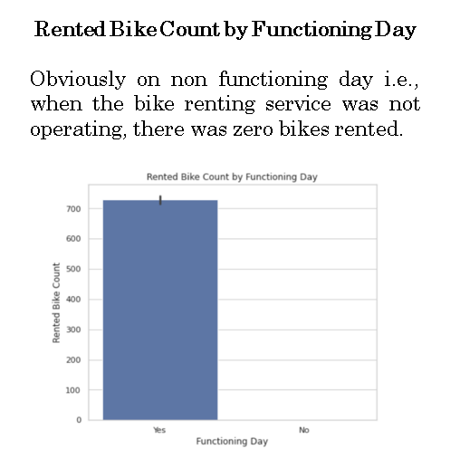
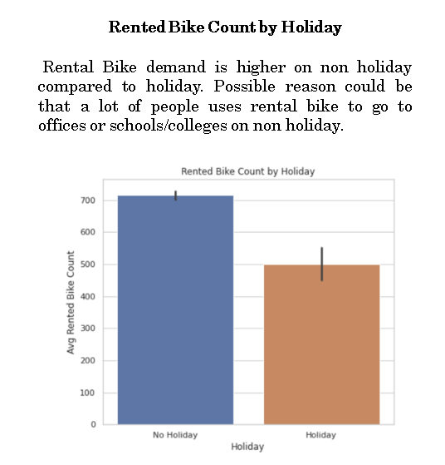
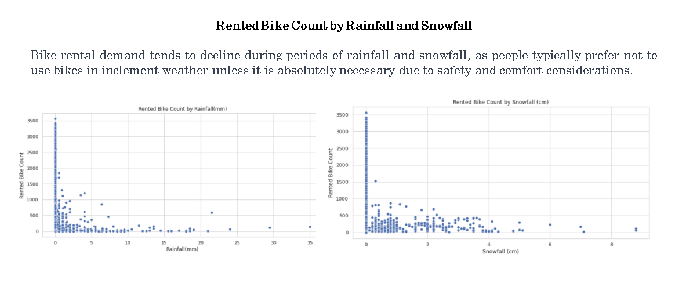
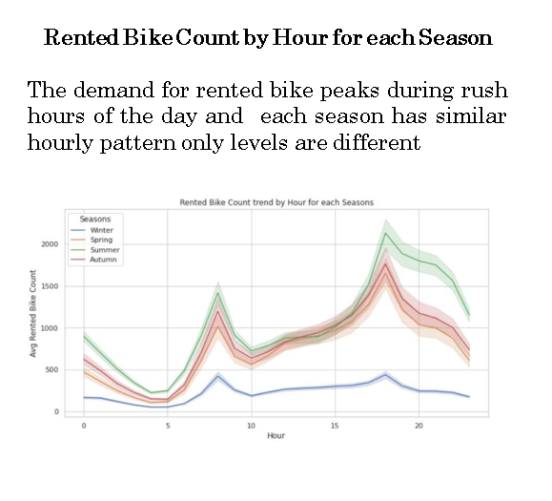

Slide 10
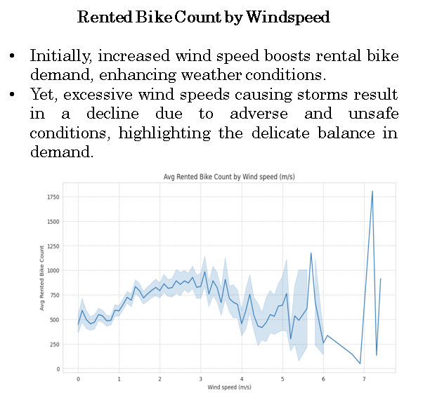
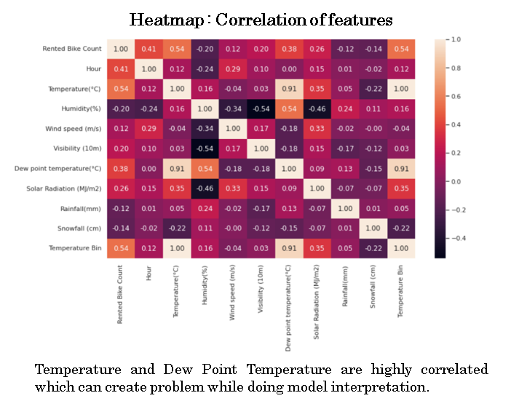
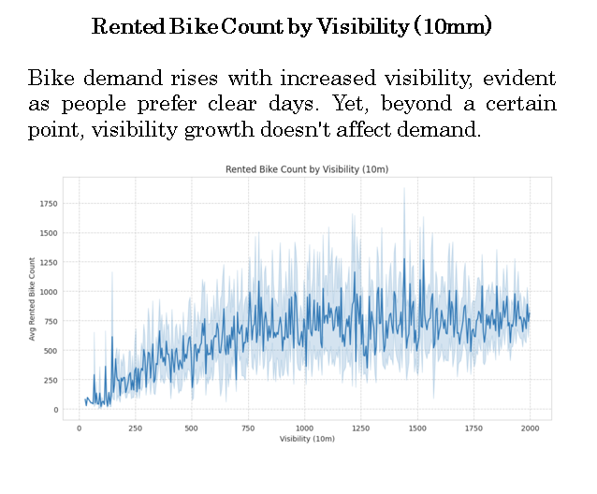

Slide 11
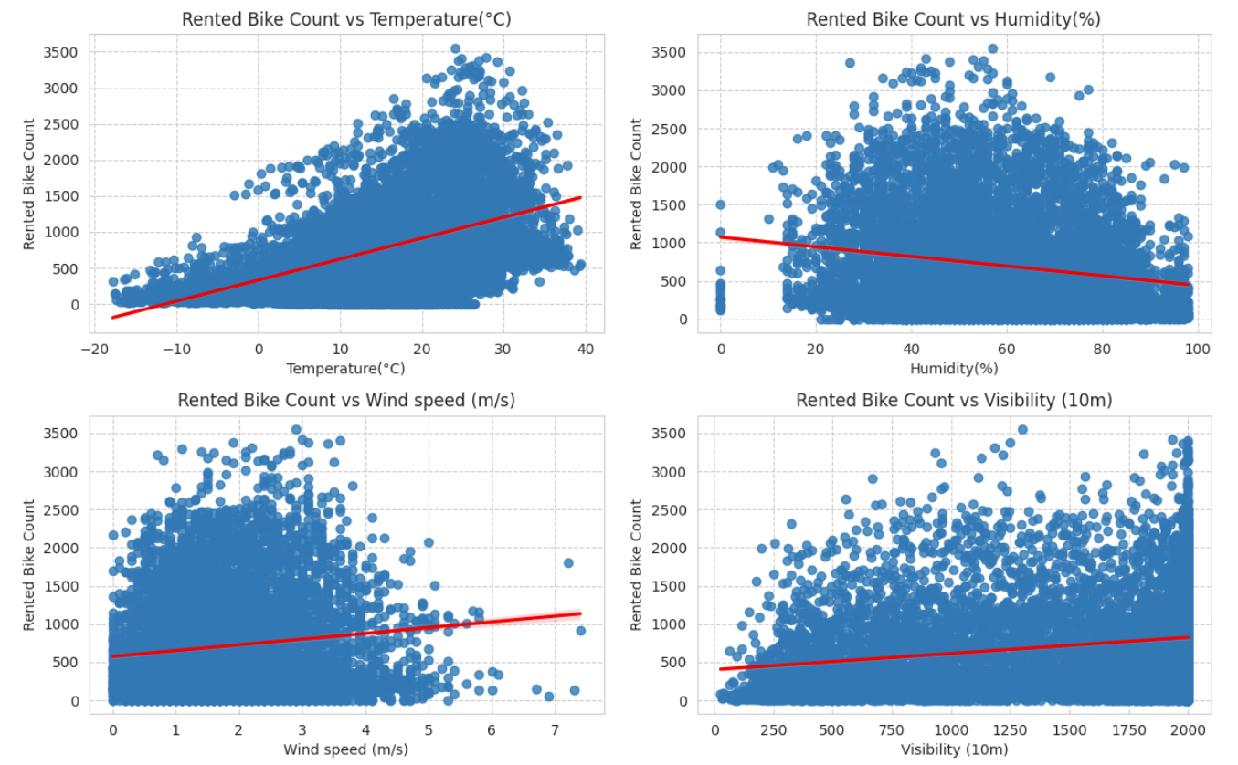
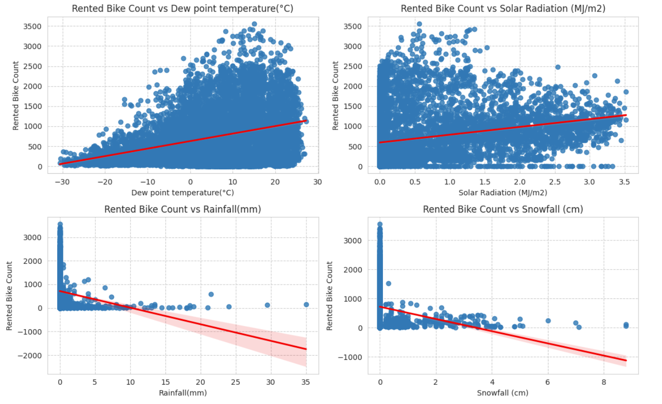
Regression Plot : Numerical features vs Rented Bike Count

Slide 12
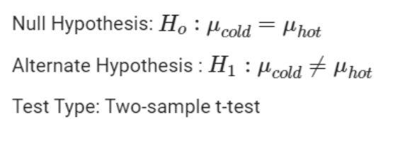
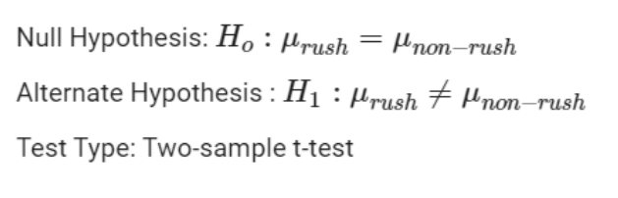
HYPOTHESIS TESTING
1. Rented Bike Demand in hot weather is higher compared to demand in cold weather.
T - Statistic : 42.27607
p-value : 0.0
Since p-value is less than 0.05, we reject the null hypothesis.ie, Rented Bike Demand in hot weather is higher compared to demand in cold weather.
2. Rented Bike Demand during rush hour (7-9AM & 5-7PM) is higher compared to non- rush hour.
T - Statistic : 22.54238
p-value : 9.381784283723713e-104
Since p-value is less than 0.05, we reject null hypothesis.ie, Rented Bike Demand during rush hour (7-9AM & 5-7PM) is higher compared to non- rush hour.

Slide 13
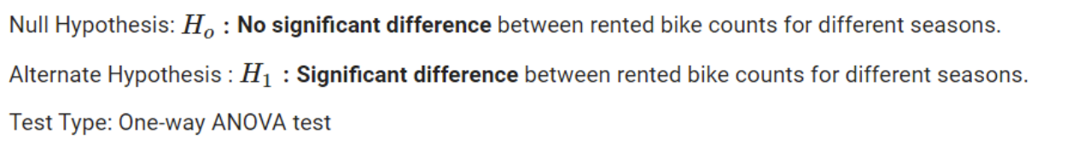
3. Rented Bike Demand is different in different seasons with highest in summer and lowest in winter.
One-way analysis of variance (ANOVA) is a statistical test used to determine whether there are any statistically significant differences between the means of three or more independent groups. In the context of the rented bike demand across different seasons, a one-way ANOVA can be used to assess whether there are significant differences in the mean demand across Summer, Autumn, Winter, and Spring.
F - Statistic : 776.467815
p-value : 0.0
Since p-value is less than 0.05, we reject null hypothesis.ie, Rented Bike Demand is different in different seasons with highest in summer and lowest in winter.

Slide 14
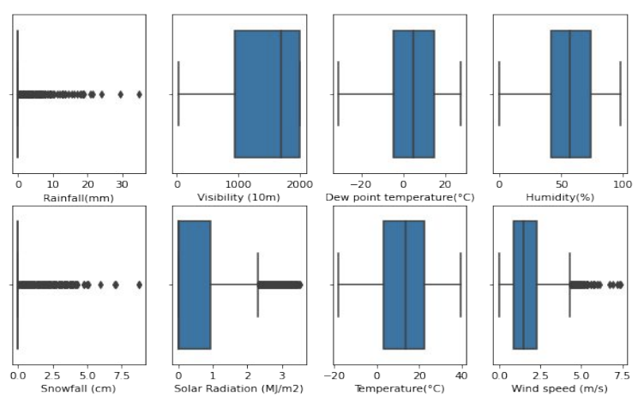
FEATURE ENGINEERING
OUTLIER TREATMENT
From distribution plots of different features, outliers are present in
Rainfall(mm), Snowfall (cm) columns
Most of the values are zero and few are non zero which is understandable as we don't see rain and snow everyday. Based on the nature of data, it is unlikely that the nonzero values represent outliers. Hence used 99th quantile for capping outliers.
Wind speed (m/s), Solar Radiation (MJ/m2) columns
The distribution of values are right skewed. Hence used IQR method for capping outliers.
The NULL values created in place of these outliers are imputed with the median value of that particular column or field.

Slide 15
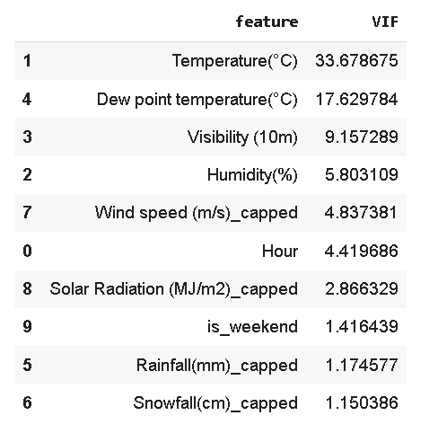
FEATURE ENCODING
Machine learning models can only work with numerical values and therefore we have to turn the categorical columns to numerical columns, and this is achieved by feature encoding.
Used ONE-HOT ENCODING to convert categorical columns Seasons, Holiday, Month, Weekday columns to numerical columns.
MULTI- COLLINEARITY CHECK FOR FEATURE REMOVAL
Multicollinearity is when two independent variables are highly correlated to each other.
Used VIF for checking multicollinearity.
Dew Point Temperature is highly correlated to Temperature. Hence dropped Dew Point Temperature column.

Slide 16
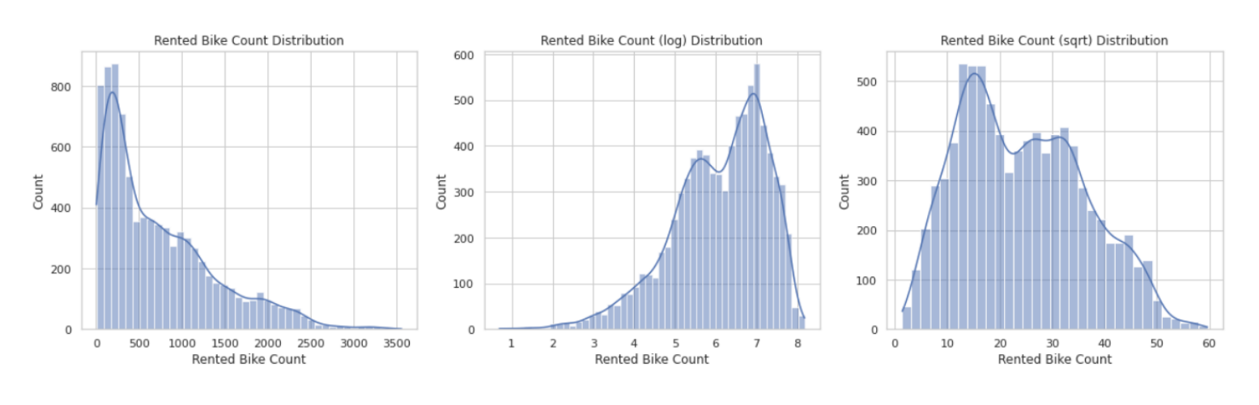
The distribution of Rented Bike Count (target variable) was right skewed, and to train a robust model we can transform it to normal. Applied square root to transform it to normal.
Similarly applied square root to Wind Speed (m/s) to transform it to normal as it was originally skewed

Slide 17
MODEL IMPLEMENTATION
The Rented Bike Count (target variable) is continuous in nature.
Used various regression algorithms along with hyper parameter tuning and cross validation to get the best model.
Algorithms used:
• Linear Regression
• XGBoost Regressor
• Decision Tree Regressor
• Random Forest Regressor

Slide 18
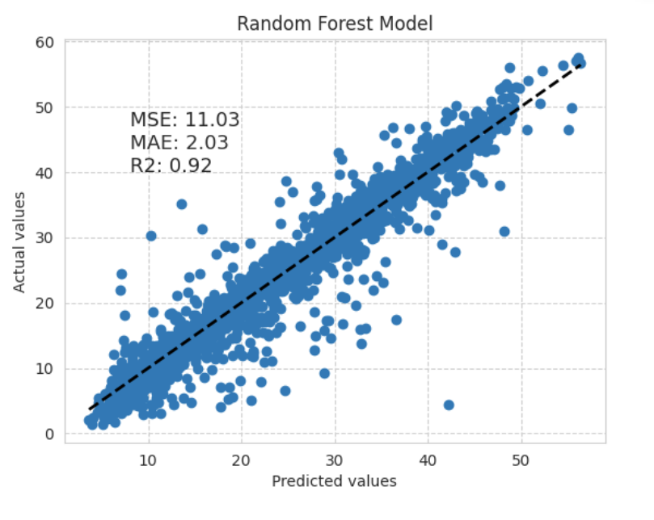
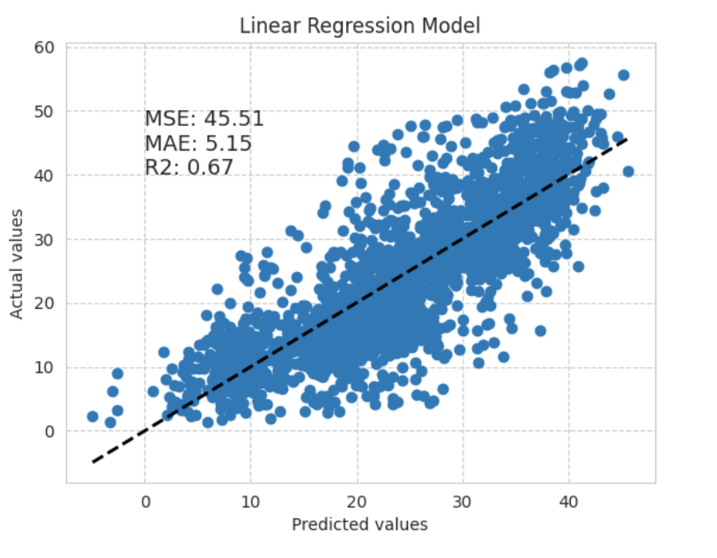
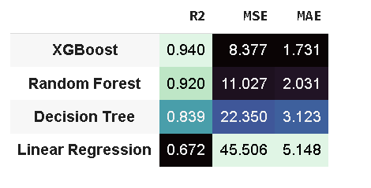
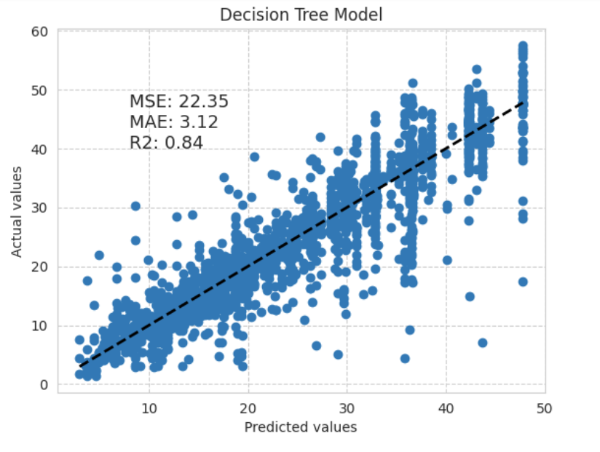
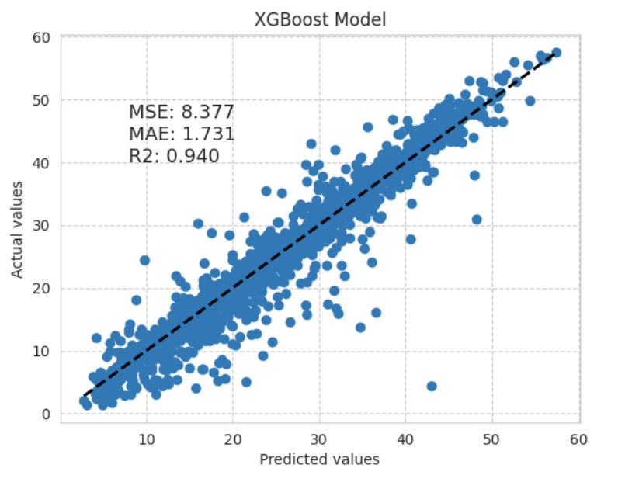
MODEL PERFORMANCE EVALUATION
The XGBoost model is the best choice for this dataset as it has the highest R2 score, the lowest MSE, and the lowest MAE

Slide 19
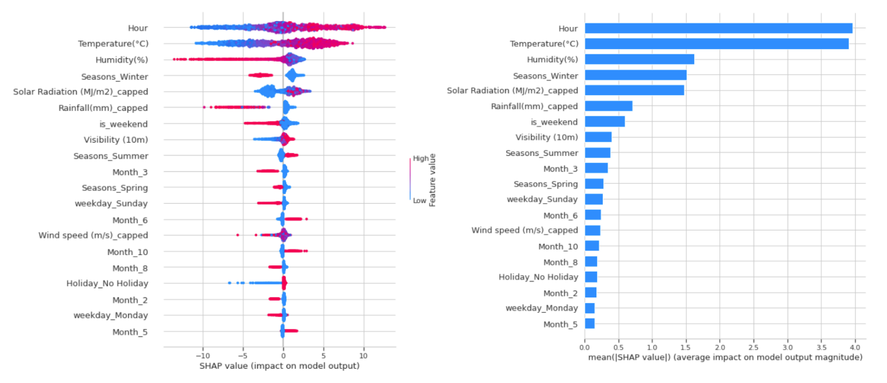
MODEL INTERPRETATION

Slide 20
CONCLUSION
Challenges faced:
❖ Removing Outliers.
❖ Encoding the categorical columns.
❖ Removing Multicollinearity from the dataset.
❖ Choosing Model explainability technique.
XGBoost model seems to be the best choice for this dataset as it has the highest R2 score, the lowest MSE, and the lowest MAE. Linear Regression Model is the worst model.
Hour and Temperature are the two most important feature to predict rental bike demand followed by Humidity, Solar Radiation, Rainfall etc.

Slide 21
Streamlit Application Link
https://mrudulascifor-mtwkcze5ghzk2ncvu9ghby.streamlit.app/
Thank You…

